Slide 1
Lecture 15
Signals and Systems (ELL205)
By Dr. Abhishek Dixit
Dept. of Electrical Engineering
IIT Delhi

Slide 2
Analysis and Synthesis equation
$$x\left(t\right)=x\left(t+T\right)=\sum_{k}{a_{k}e^{jkω_{o}t}}$$
Synthesis
$$ak=\frac{1}{T}\int_{T}{x\left(t\right)e^{−jkω_{o}t}dt}$$
Analysis

Slide 3
Question
$$x\left(t\right)=\left\{\begin{aligned}1 \left|t\right|<T1 \\ 0 T1<\left|t\right|≤T\end{aligned}\right.$$
-T₁
T₁
-T/2 0 T/2
How many of the following statements are correct?
1. $ak$ are real and even | 2. $ak$ are imaginary and odd
3. $ak$ is 0 if $k$ is even but not zero and duty cycle is 50% | 4. $ak$ decreases as $k$ increases

Slide 4
Obs. 2 Real & Even together
$$x\left(t\right)↔ak$$
$$x\left(−t\right)↔a_{−k}$$
$$\overline{x\left(t\right)}↔\overline{a_{−k}}$$
If then &
Odd:
$$ak={−a}_{−}k$$
Signal | Coefficients
Real & Even | Real & Even
Real & Odd | Imaginary & Odd
Imaginary & Even | Imaginary & Even
Imaginary & Odd | Real & Odd
Imag.:
$$ak=−\overline{a_{−}k }$$
Imag. & Odd:
$$ak=−\overline{a_{−}k }=\overline{a_{k}}$$

Slide 5
Working out the mechanics
$$a_{k}=\frac{1}{jkω_{o}T}\left[e^{jkω_{o}T1}−e^{−jkω_{o}T1}\right]$$
=$\frac{2}{kω_{o}T}sin⁡(kω_{o}T1)$
=$\frac{2T1}{T}\frac{sin⁡(kω_{o}T1) }{kω_{o}T1}$
=$\frac{2T1}{T}sinc(kω_{o}T1)$
where $sinc(θ)=\frac{sinθ}{θ}$
where $D=\frac{2T1}{T}$
=$Dsinc(kπD)$

Slide 6
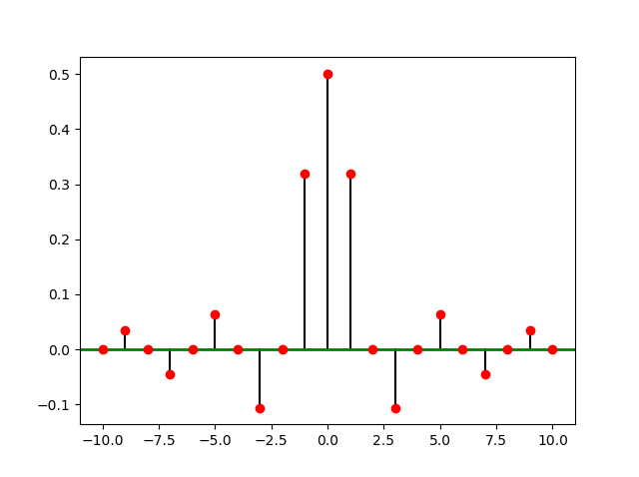
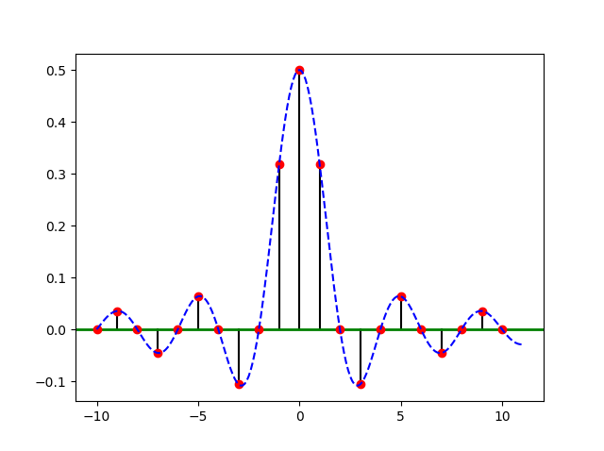
Working out the mechanics
$$a_{k}=\frac{1}{2}sinc(kπ/2)$$
where $sinc(θ)=\frac{sinθ}{θ}$

Slide 7
Question
2T₁
-T/2 0 T/2
$$bk$$
The signal has FS coefficients as . How many of the following statements are correct?
1. $bk$have the same magnitude as $ak$ | 2. $bk$ have the same phase as $ak$
3. | 4.
$$bk=e^{−jkωoT_{1} }ak$$
$$bk=e^{jkωoT_{1} }ak$$
$a_{k}$ are the Fourier series coefficients of the previous signal.

Slide 8
Time-shifting
$$x\left(t\right)↔ak$$
$$x\left(t−t_{o}\right)↔e^{−jkωoto }ak$$
If then

Slide 9
Time-shifting
$$x\left(t\right)↔ak$$
$$x\left(t−t_{o}\right)↔e^{−jkωoto }ak$$
If then
Proof:
$$bk=\frac{1}{T}\int_{T}{x\left(t−t_{o}\right)e^{−jkω_{o}t}dt}$$
Starting from & changing variable of
integration as
we get
$$t−t_{o}=λ$$
$$bk=\frac{1}{T}\int_{T}{x\left(λ\right)e^{−jkωo(λ+to )}}dλ$$
On simplification, we get
$$bk=e^{−jkωoto }ak$$

Slide 10
Question
2T₁
-T/2 0 T/2
$$bk$$
The signal has FS coefficients as . How many of the following statements are correct?
1. $bk$ have the same magnitude as $ak$ | 2. $bk$ have the same phase as $ak$
3. | 4.
$$bk=e^{−jkωoT_{1} }ak$$
$$bk=e^{jkωoT_{1} }ak$$
$a_{k}$ are the Fourier series coefficients of the previous signal.

Slide 11
List of Properties
Signal | Coefficients
Real & Even | Real & Even
Real & Odd | Imaginary & Odd
Imaginary & Even | Imaginary & Even
Imaginary & Odd | Real & Odd
1.
$$x\left(t\right)↔ak$$
2.
$$x\left(−t\right)↔a_{−k}$$
3.
$$\overline{x\left(t\right)}↔\overline{a_{−k}}$$
4.
$$x\left(t−t_{o}\right)↔e^{−jkωoto }ak$$

Slide 12
List of Properties
Signal | Coefficients
Real & Even | Real & Even
Real & Odd | Imaginary & Odd
Imaginary & Even | Imaginary & Even
Imaginary & Odd | Real & Odd
Shifted signal | Only phase changes
1.
$$x\left(t\right)↔ak$$
2.
$$x\left(−t\right)↔a_{−k}$$
3.
$$\overline{x\left(t\right)}↔\overline{a_{−k}}$$
4.
$$x\left(t−t_{o}\right)↔e^{−jkωoto }ak$$

Slide 13


Use properties
$$a_{k}$$
--1.0 -0.5 -0.25 0 0.25 0.5 1
$$b_{k}=?$$
--1.0 -0.5 -0.25 0 0.25 0.5 1

Slide 14
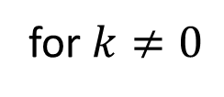


Use properties
$$a_{k}$$
--1.0 -0.5 -0.25 0 0.25 0.5 1
$$b_{k}=?$$
--1.0 -0.5 -0.25 0 0.25 0.5 1
$$b_{k}=a_{k}$$
for $k≠0$
$$b_{o}=0$$

Slide 15


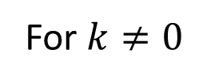
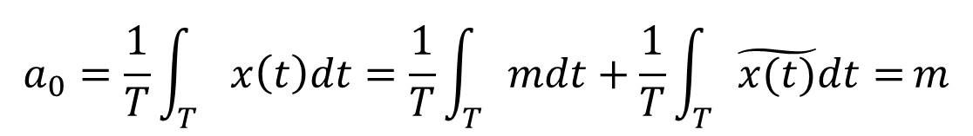
Use properties
$$x\left(t\right)=m+\tilde{x(t)}$$
$$\tilde{x(t)}$$
has mean value 0
$$a_{0}=\frac{1}{T}\int_{T}{x\left(t\right)dt=\frac{1}{T}\int_{T}{mdt}+\frac{1}{T}\int_{T}{\tilde{x(t)}dt=}}m$$
$$a_{k}=\frac{1}{T}\int_{T}{x\left(t\right)e^{−jkω_{0}t}dt=\frac{m}{T}\int_{T}{e^{−jkω_{0}t}dt}+\frac{1}{T}\int_{T}{\tilde{x(t)}e^{−jkω_{0}t}dt=}}0+b_{k}$$
For $k≠0$

Slide 16
Convergence of Fourier Series
$$x_{N}\left(t\right)≜\sum_{k=−N}^{N}{a_{k}e^{jkω_{o}t}}$$
$$e_{N}\left(t\right)≜{x\left(t\right)−x}_{N}\left(t\right)$$
Does $e_{N}\left(t\right)$ decrease as N increases?

Slide 17
Convergence of Fourier Series
Convergence of the Fourier Series by incrementally adding terms.
Example: square wave
t

Slide 18
Convergence of Fourier Series
Convergence of the Fourier Series by incrementally adding terms.
Example: square wave
t

Slide 19
Convergence of Fourier Series
Convergence of the Fourier Series by incrementally adding terms.
Example: square wave
t

Slide 20
Convergence of Fourier Series
Convergence of the Fourier Series by incrementally adding terms.
Example: square wave
t

Slide 21
Convergence of Fourier Series
Convergence of the Fourier Series by incrementally adding terms.
Example: square wave
t

Slide 22
Convergence of Fourier Series
Convergence of the Fourier Series by incrementally adding terms.
Example: square wave
t

Slide 23
Convergence of Fourier Series
Convergence of the Fourier Series by incrementally adding terms.
Example: square wave
t

Slide 24
Convergence of Fourier Series
Convergence of the Fourier Series by incrementally adding terms.
Example: square wave
t

Slide 25
Convergence of Fourier Series
Convergence of the Fourier Series by incrementally adding terms.
Example: square wave
t

Slide 26
Convergence of Fourier Series
Convergence of the Fourier Series by incrementally adding terms.
Example: square wave
t

Slide 27
Convergence of Fourier Series
Convergence of the Fourier Series by incrementally adding terms.
Example: square wave
t

Slide 28
Convergence of Fourier Series
Albert Michelson horror
9%
t

Slide 29
Convergence of Fourier Series
Albert Michelson horror
Partial sums of Fourier series of discontinuous functions “ring” near discontinuities: Gibb’s phenomenon.
9%
t

Slide 30
Energy in Error

Slide 31
Convergence of Fourier Series
$x\left(τ\right)$ square integrable,
If $\int_{T}{{\left|x(τ)\right|}^{2}dτ<∞}$
Then $\int_{T}{{\left|e_{N}\left(t\right)\right|}^{2}dt→0}$ as $N→∞$
Dirichlet conditions
If $\int_{T}{\left|x(τ)\right|dτ<∞}$ and $x(t)$ is “well-behaved”
Then $e_{N}\left(t\right)→0$ as $N→ ∞$ except at discontinuities

Slide 32
Convergence of Fourier Series
$x\left(τ\right)$ square integrable,
If $\int_{T}{{\left|x(τ)\right|}^{2}dτ<∞}$Then $\int_{T}{{\left|e_{N}\left(t\right)\right|}^{2}dt→0}$ as $N→∞$
$$\lim_{N→∞}\left(\int_{T}{{\left|x\left(t\right)−\sum_{k=−N}^{N}{a_{k}e^{jkω_{o}t}}\right|}^{2}dt}\right){→0}$$
$$x\left(t\right)≜l.i.m\sum_{k=−∞}^{∞}{a_{k}e^{jkω_{o}t}}$$

